Slide 1
Programming Fundamentals
Lecture 17

Slide 2
Objectives
C – String
Standard String Class in C++
Declaring and defining string objects
Using operators with string objects
Some built-in string class functions

Slide 3
C-Strings
A C-string is viewed as an array of characters
You need to declare the array of characters of a fix size
char str[50];
Here str is a c-string which can save up to 50 characters
If you enter more characters then an overflow will occur
So you need to declare an array of right size for each string

Slide 4
Standard String Class
Standard C++ includes a new class called string. This class improves on the traditional C-string in many ways
  For one thing, you no longer need to worry about creating an array of the right size to hold string variables. The string class assumes all the responsibility for memory management
  Also, the string class allows the use of overloaded operators, so you can concatenate string objects with the + operator like s3 = s1 + s2

Slide 5
Defining and Assigning string Objects
You can define a string object in several ways
Identify the constructor called for these declarations
You can use a constructor with no arguments, creating an empty string
You can also use a one-argument constructor
Objects of class string can be assigned to one another with a simple assignment operator
    string s1;
    string s2(“Student Name”);
    string s3 = “Course Name”;
    s1 = s3;
    string s4(s2); // is this valid??

Slide 6
Input/Output with string Objects
For string input if we want NOT to read empty spaces then we use cin
  string s1;
  cin>>s1;
If we want to read the empty spaces then we use getline() function
  getline(cin, s1);
If we want to take the string input in several lines then another argument should be added in getline() function
  getline(cin, s1, ‘$’);
The above line will keep on asking the string until you press $ character

Slide 7
fflush(stdin) Function
You may notice an abnormal behavior while inputting the strings
This is due to mixing of cin and getline()
If you are mixing the cin and getline then you need to use fflush(stdin) function
The fflush(stdin) function tells the compiler that most recent action was not an input, it clears the stdin buffer before proceeding to next input command (fflush() only works with windows)

Slide 8
Operators with String Objects
+ Operator will concatenate two string
+= will append a string to another
== will compare two string objects over equality
< and > will compare the strings alphabetically
Compile and Execute the file named “Operators_with_string_objects” and answer the following questions
  What will happen with += operator if string 2 is already a part of string s1 and you are writing s2 += s1?
  There are two strings with same lengths but with different characters, are they equal?
  When we compare two string with == operator, the strings are compared alphabetically, or the whole string is compared?
  If strings contain special characters, then how we can use < and > operator?

Slide 9
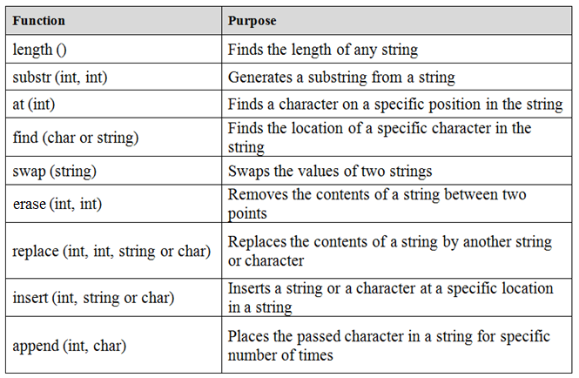
Some Built-in String Class Functions
There are several built-in string class functions, some of them are given below

Slide 10
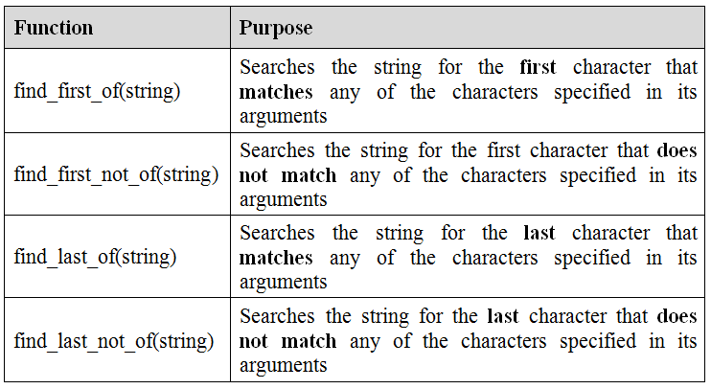
Some Built-in String Class Functions
Some more string functions are:

Slide 11
length()
This function will return the length of a string
This function has no arguments and will return an integer value
  string s1 = “This is a String”;
  int L = s1.length();
  cout<<“The length of s1 is ”<<L<<endl; // L = 16

Slide 12
substr(int, int)
This function generates another string from an existing string
This function accepts two integers as argument and will return a string
  The first integer is the starting position of substring
  The second integer is the number of characters in the substring
    string s1 = “This is a String”;
    string s2 = s1.substr(5, 8);
    cout<<s2; //s2 = is a Str

Slide 13
find(char or string)
This function returns the starting position of a character or a string
This function will accept a character or string as an argument and will return an integer
    string s1 = “This is a String”;
    int a = s1.find(‘i’);
    int b = s1.find(“String”);
    cout<<a<<endl; //a = 2
    cout<<b<<endl; //b = 10

Slide 14
at(int)
This function returns a character at a specific position in a string
This function will accept an integer as an argument and will return a character
    string s1 = “This is a String”;
    char a = s1.at(3);
    char b = s1.at(8);
    cout<<a<<endl; // s is displayed
    cout<<b<<endl; // a is displayed

Slide 15
swap(string)
This function will swap the values of two strings
This function will accept a string as an argument and logically will return two string
    string s1 = “First String”;
    string s2 = “Second String”;
    s1.swap(s2);
After the execution of above statement the value of s1 will become “Second String”, and value of s2 will be “first string”

Slide 16
erase(int, int)
This function erases a specific content from a string
This function will accept two integers as argument
  The first integer is the starting point
  The second integer is the number of characters to erase
    string s1 = “This is Not a String”;
    s1.erase(8, 3);
Not will be removed from the string
The length of string will be decreased by 3

Slide 17
replace(int, int, string)
This function replaces a specific part of a string by another string
The function accepts 3 arguments
  First integer is the starting point of the replacement character
  Second integer is the number of characters to replace
  Third argument is the string that will replace the existing characters
    string s1 = “This is Not a String”;
    string s2 = “Definitely”;
    s1.replace(8,3,s2); //method 1
    //s1.replace(8,3, “Definitely”); //method 2

Slide 18
insert(int, string)
This function inserts a specific string in another string
There are two arguments (integer and string)
  The integer in the argument is the position where the string (second argument) will be inserted
    string s1 = “I am living in USA”;
    string s2 = “ Not”;
    s1.insert(4, s2); //s2 is inserted in s1 after “I am”
    //s1.insert(4, “ Not”); //Same result

Slide 19
append(int, char)
The purpose of this function is to append a specific character in any string
This function will accept two arguments
  The first argument is an integer and it is a count that how many times a character should be appended
  The second argument is a character which you want to append
          string s1 = “XYZ”;
          s1.append(4, ‘A’);
After above instruction s1 will become XYZAAAA (A is appended 4 times)

Slide 20
find_first_of(string or char)
This function searches the string for the first character that matches with any character in the string passed as argument
The sequence of characters in the argument does not matter
The function accepts a string or a character as an argument and returns an integer
  string s1 = “This is a String”;
  int a = s1.find_first_of(“aeiou”);
  int b = s1.find_first_of(“oeiau”);
  int c = s1.find_first_of(‘a’);
After the execution the value of a and b is 2 and the value of c is 8

Slide 21
find_first_not_of(string or char)
This function searches the string for the first character that does not match with any character in the string passed as argument
The sequence of characters in the argument does not matter
The function accepts a string or a character as an argument and returns an integer
  string s1 = “This is a String”;
  int a = s1.find_first_not_of(“Thi”);
  int b = s1.find_first_not_of(“What”);
  int c = s1.find_first_not_of(‘T’);
After the execution the value of a is 3 the value of b is 0 and the value of c is 1

Slide 22
find_last_of(string or char)
This function searches the string for the last character that matches with any character in the string passed as argument
The sequence of characters in the argument does not matter
The function accepts a string or a character as an argument and returns an integer
  string s1 = “This is a String”;
  int a = s1.find_last_of(“aeiou”);
  int b = s1.find_last_of(“oeiau”);
  int c = s1.find_last_of(‘s’);
After the execution the value of a and b is 13 and the value of c is 6

Slide 23
find_last_not_of(string or char)
This function searches the string for the last character that does not match with any character in the string passed as argument
The sequence of characters in the argument does not matter
The function accepts a string or a character as an argument and returns an integer
  string s1 = “This is a String”;
  int a = s1.find_last_not_of(“ing”);
  int b = s1.find_last_not_of(“What”);
  int c = s1.find_last_not_of(‘g’);
After the execution the value of a is 12 the value of b is 15 and the value of c is 14

